Slide 1
Introducing the
Rappture Toolkit
Derrick Kearney
HUBzero® Platform for Scientific Collaboration
Purdue University
Original slides by Michael McLennan
This work licensed under
Creative Commons
See license online:
by-nc-sa/3.0

Slide 2

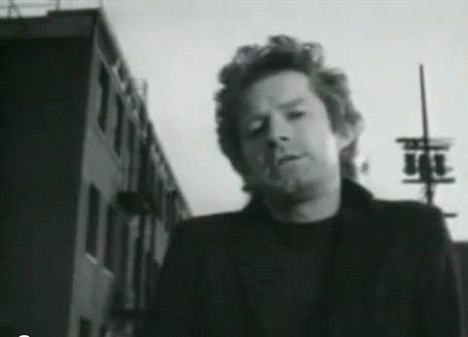
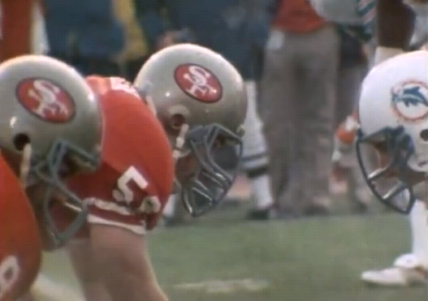
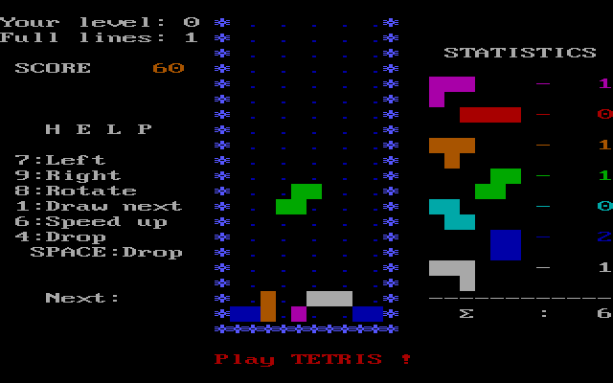
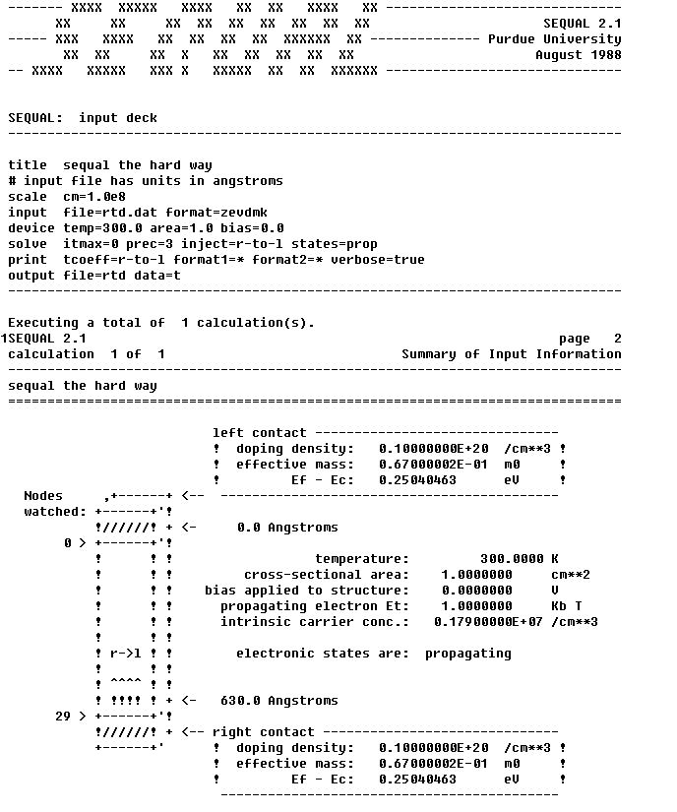

Take a trip back to 1985…
The Boys of Summer
Don Henley
Superbowl XIX: 49ers vs Miami
Copyright Universal Pictures
picture from imdb.com
Video still from YouTube.com
Video still from Hulu.com
Semiconductor Electrostatics QUantum AnaLysis
SEQUAL 2.1 - 7862 lines of Fortran 77
Tetris for IBM PC
Screen shot from Wikipedia.org
Resonant
Tunneling
Diode

Slide 3
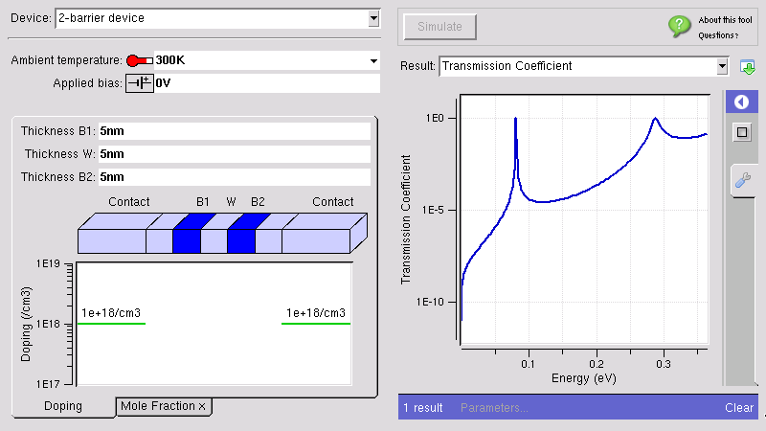

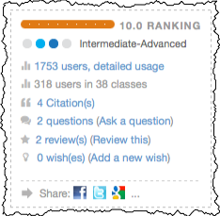
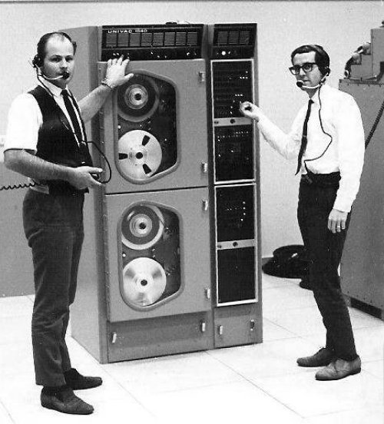
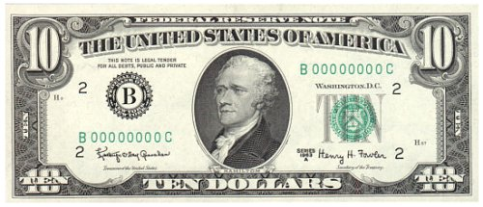
Now, back to the present…
Magnetic Tape:
$10
Live Tool:
Priceless

Slide 4


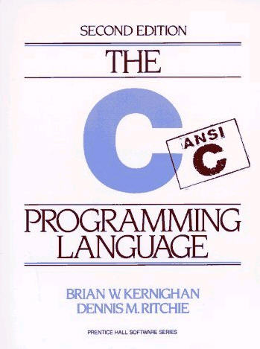





Introducing: The Rappture Toolkit
inputs
outputs
Rappture
Rapid Application Infrastructure
Released in May 2005
Open Source (rappture.org)
Create standard desktop apps
Works with your favorite
programming language

Slide 5
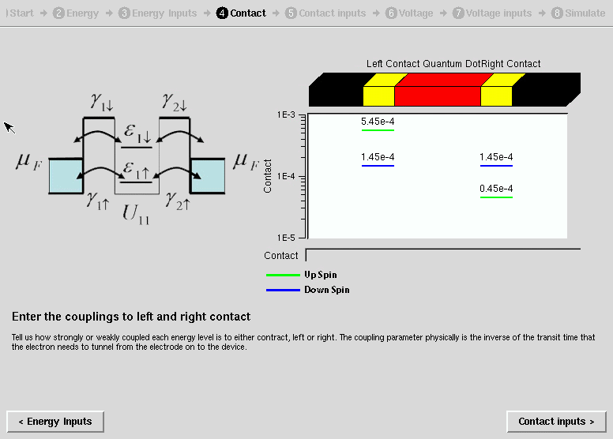

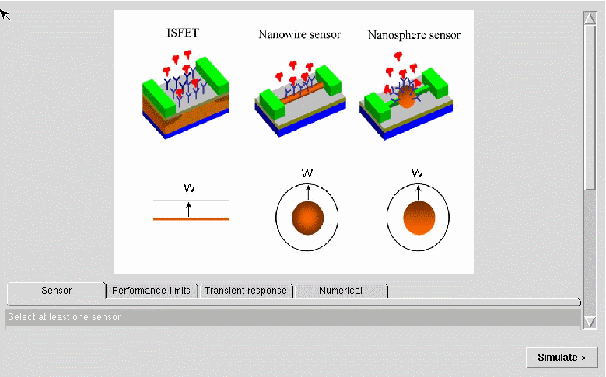
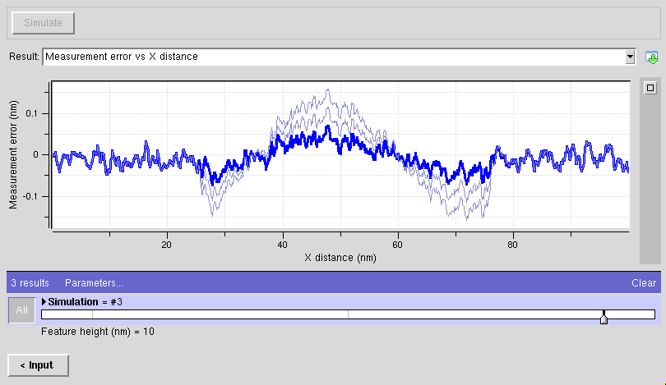
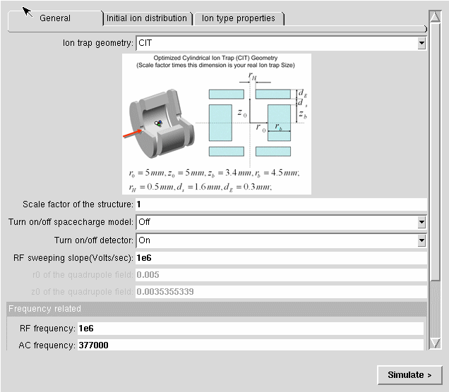
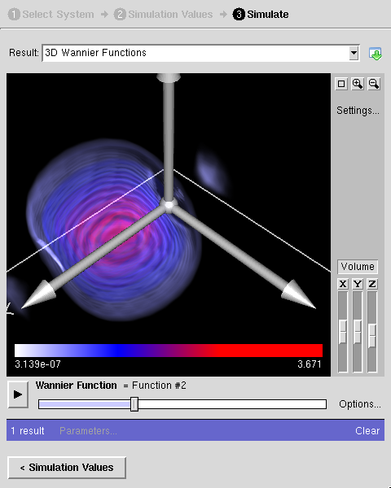
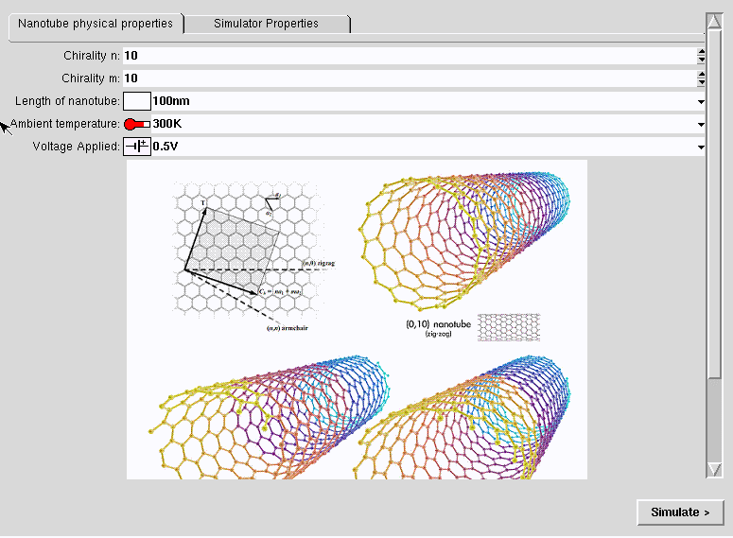
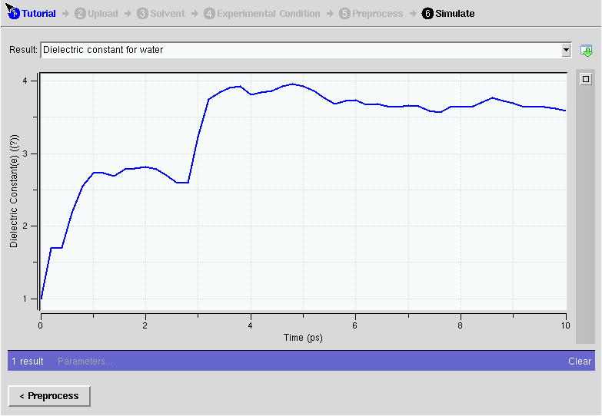
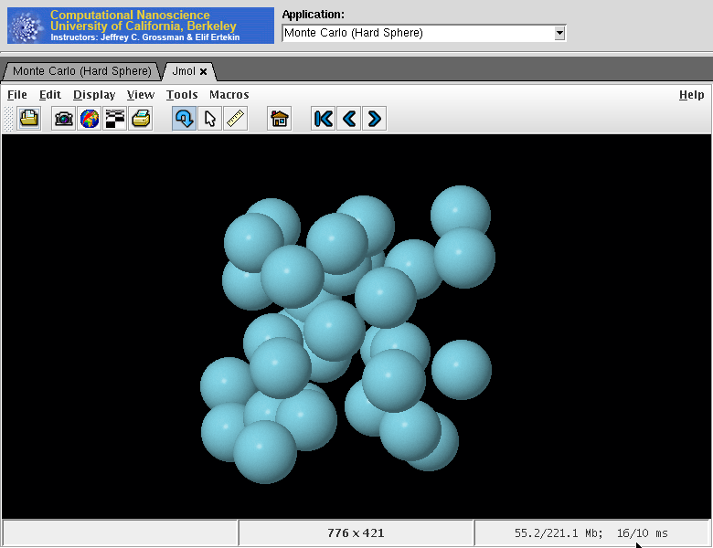
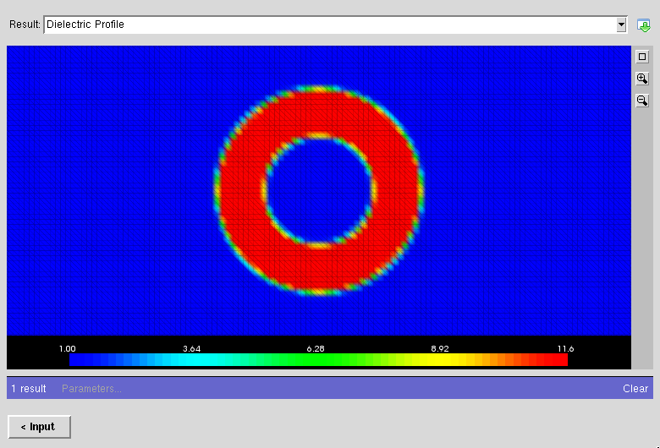
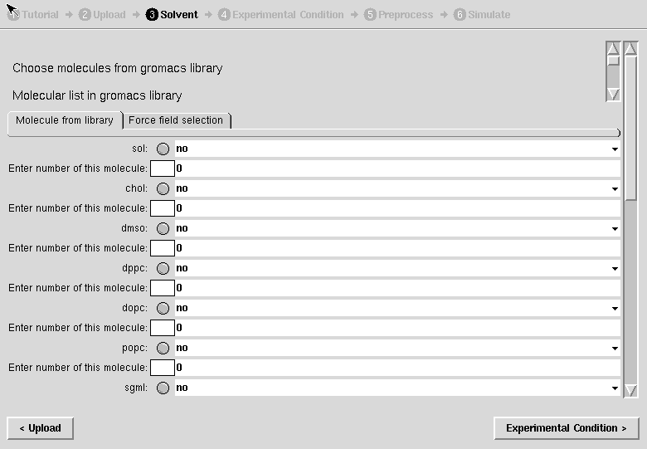
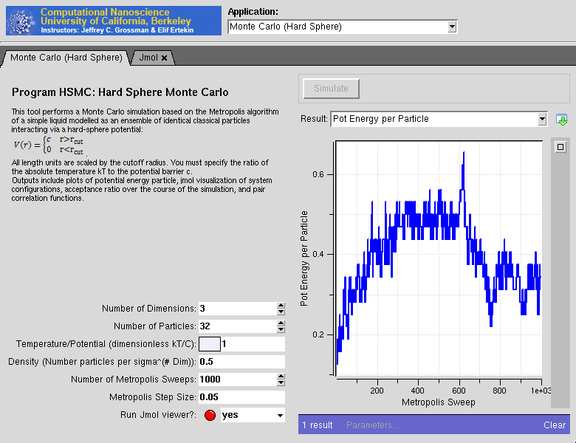
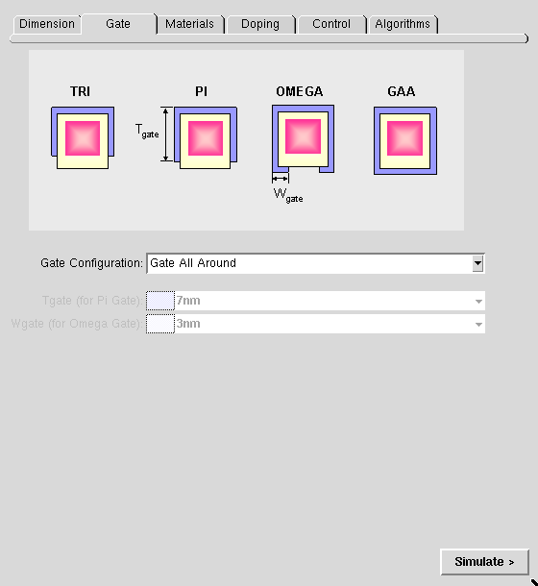
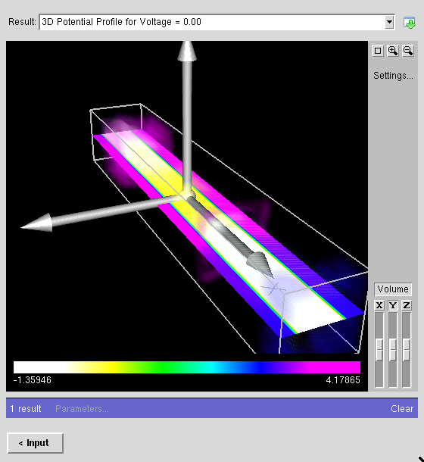
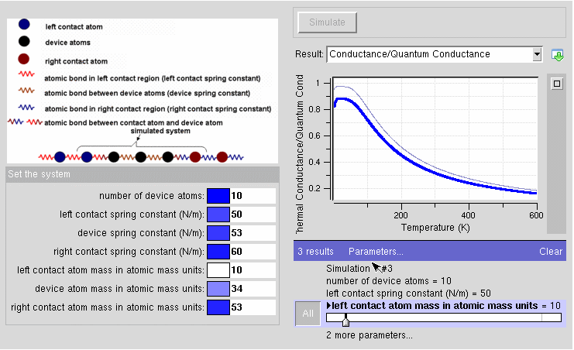
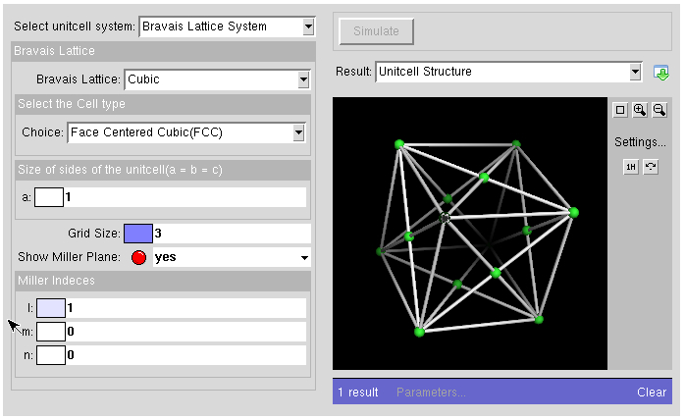
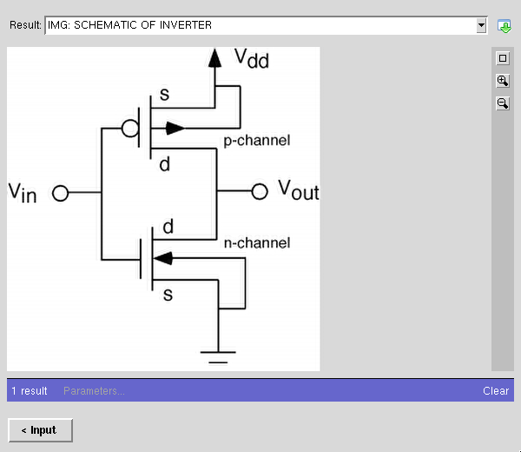
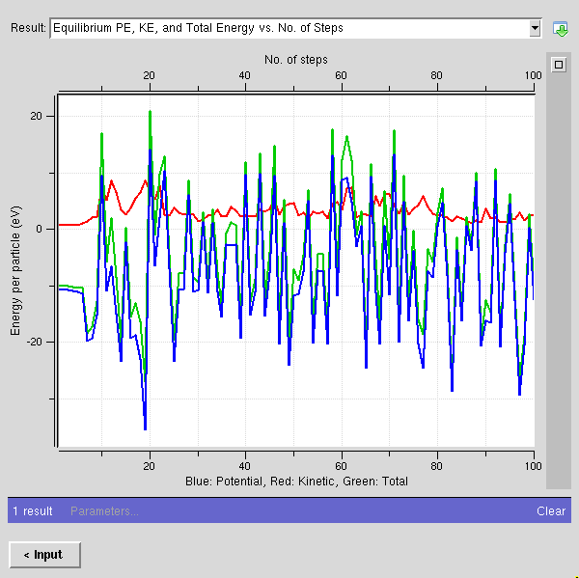
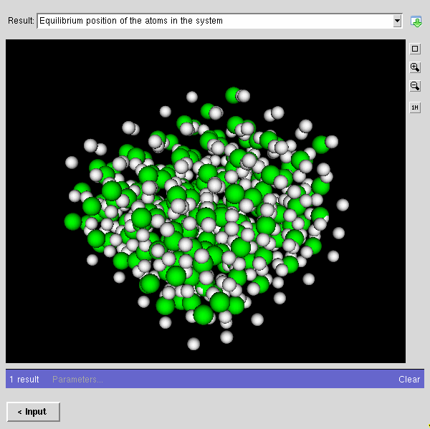
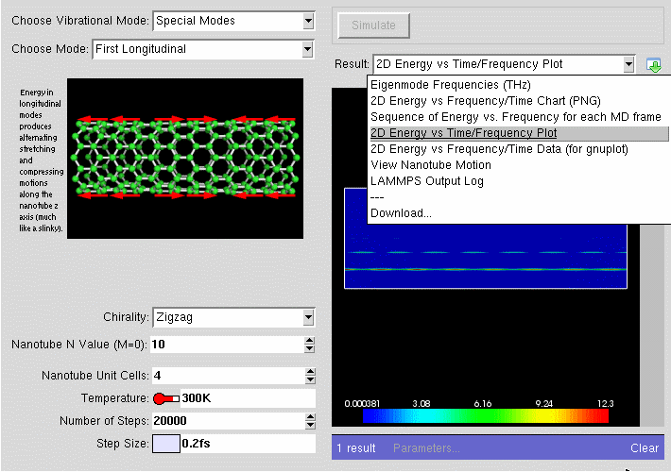
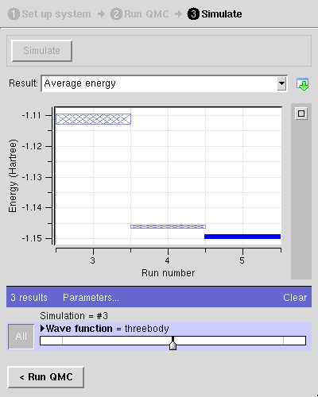
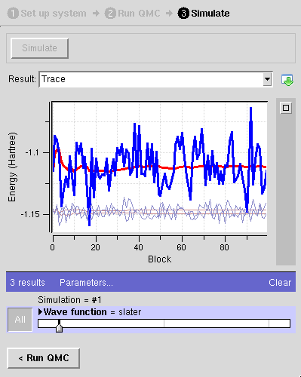
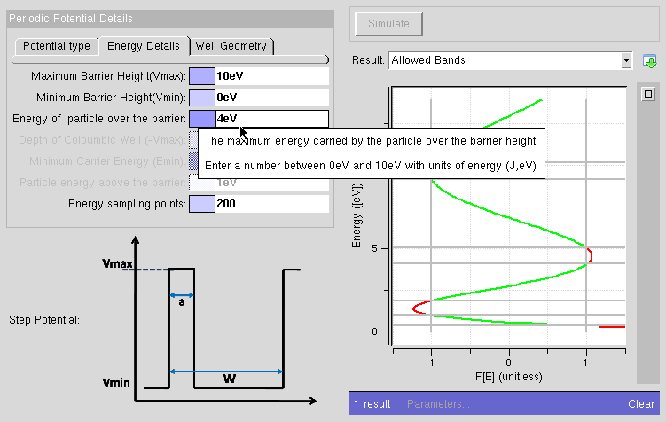
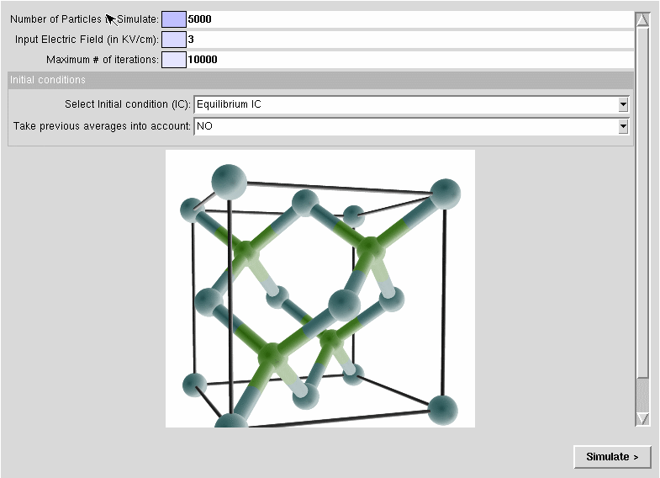
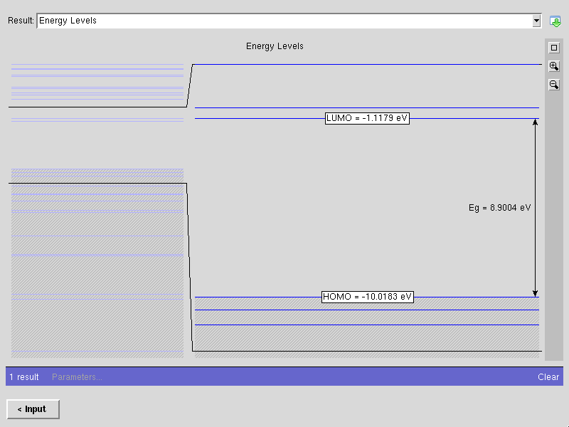
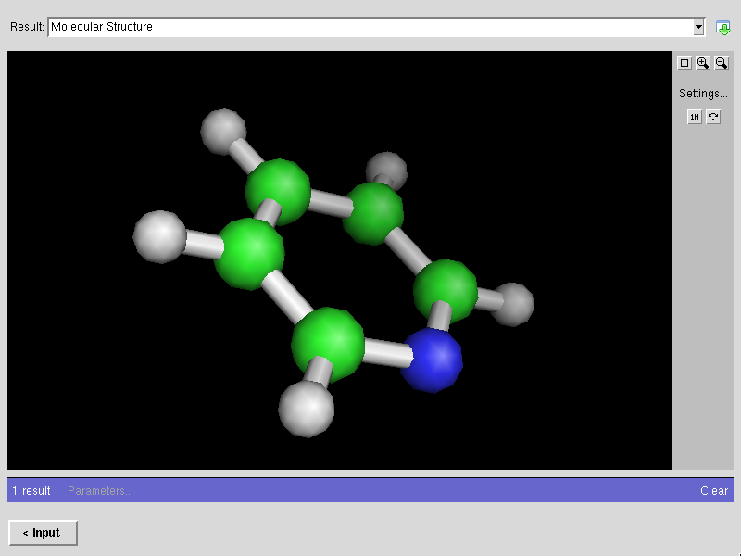
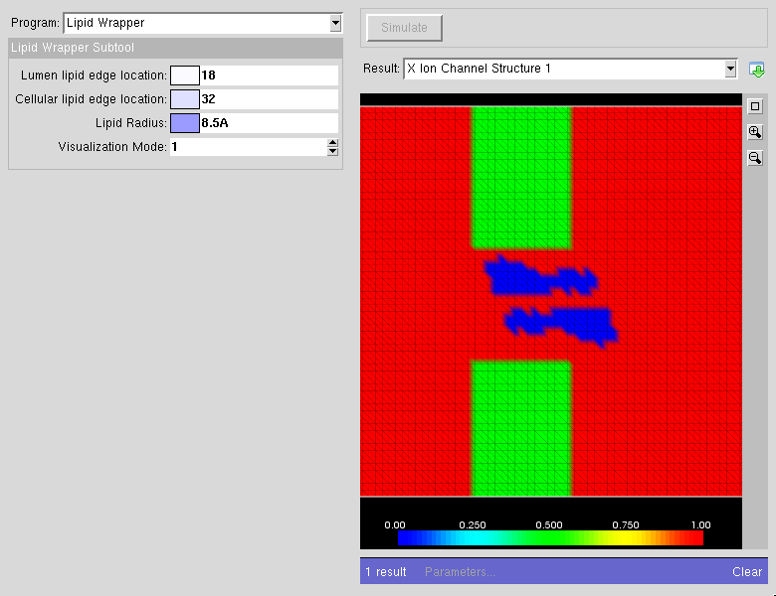
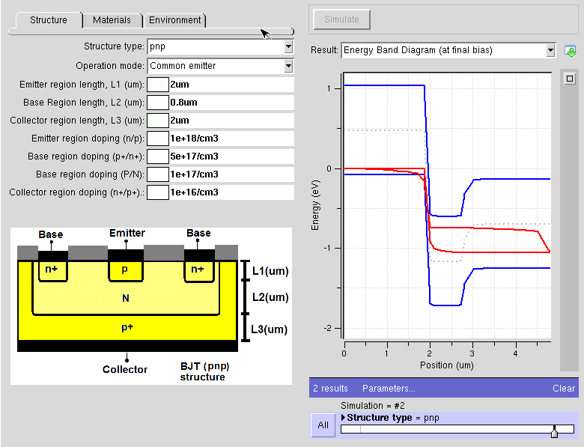
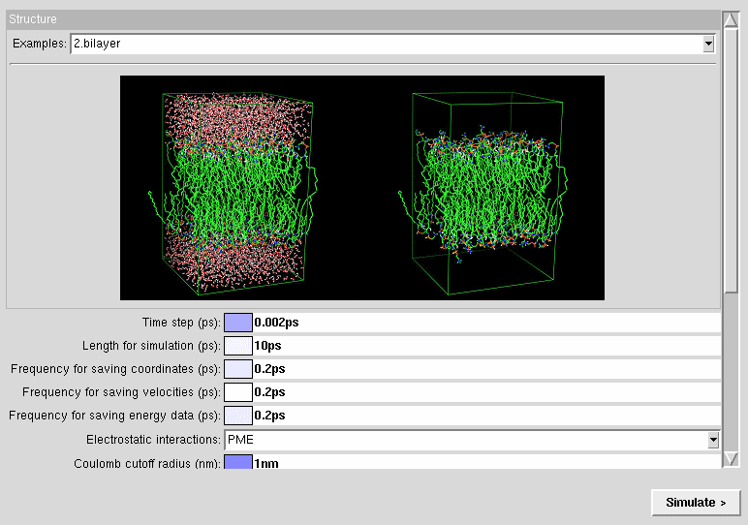
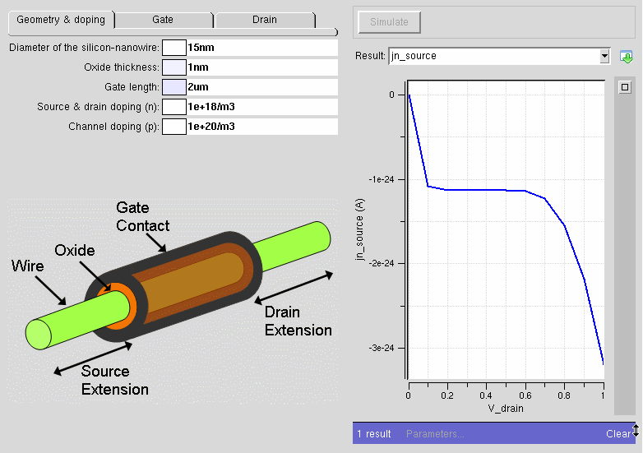
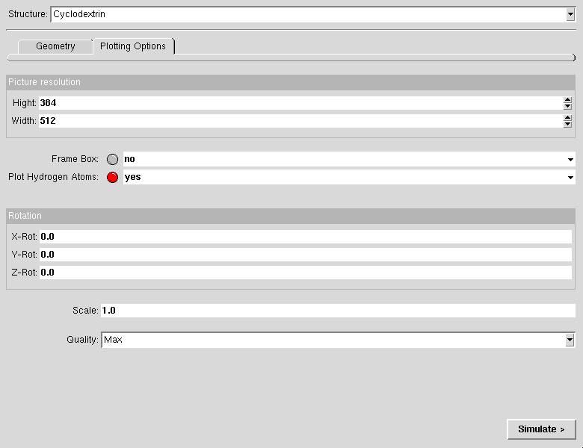
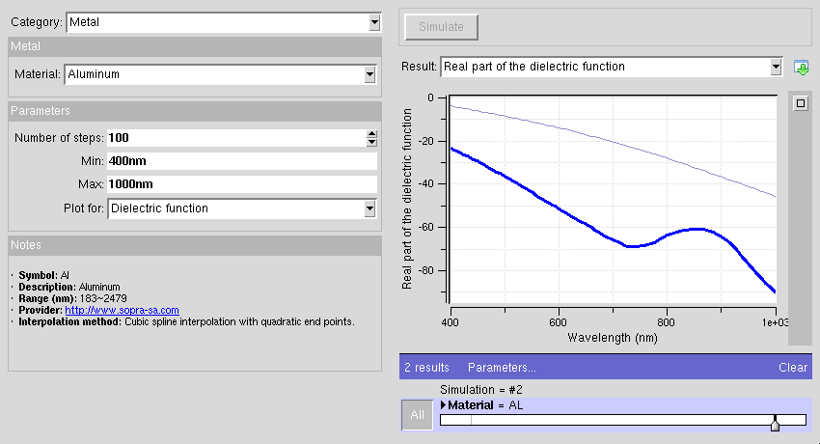
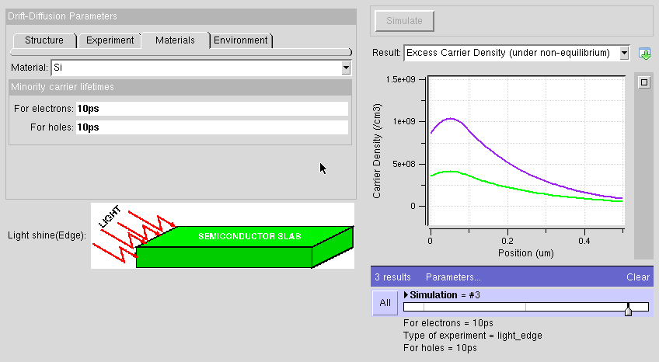
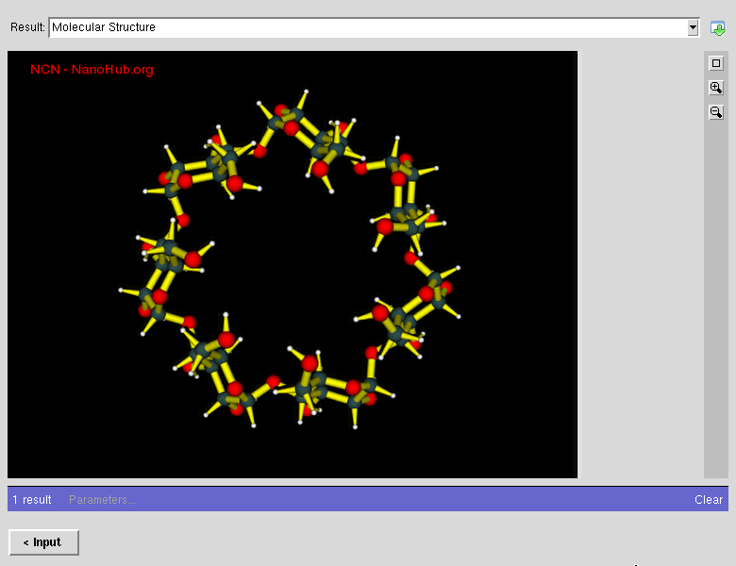
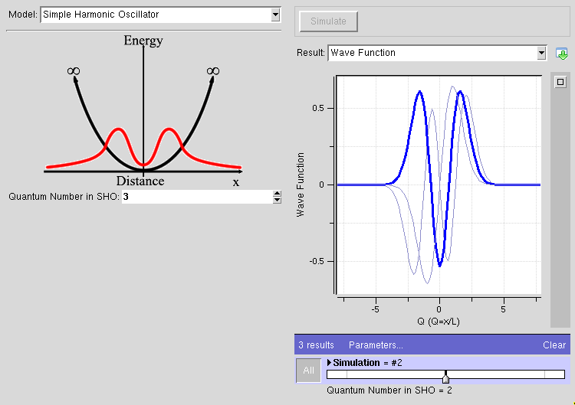
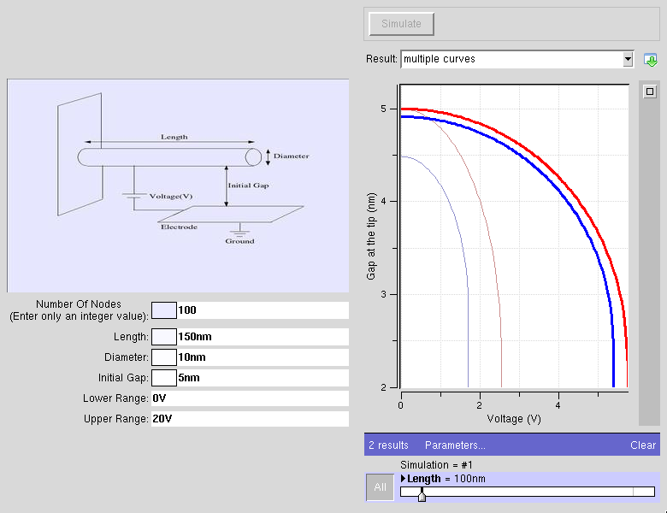
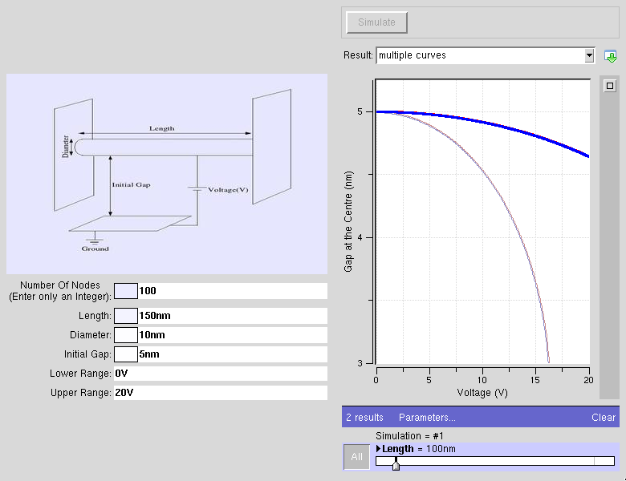
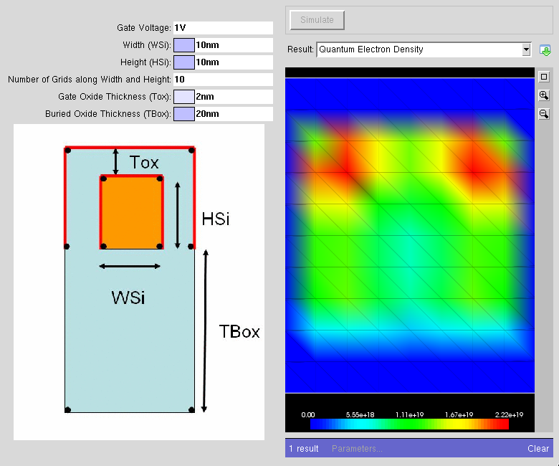
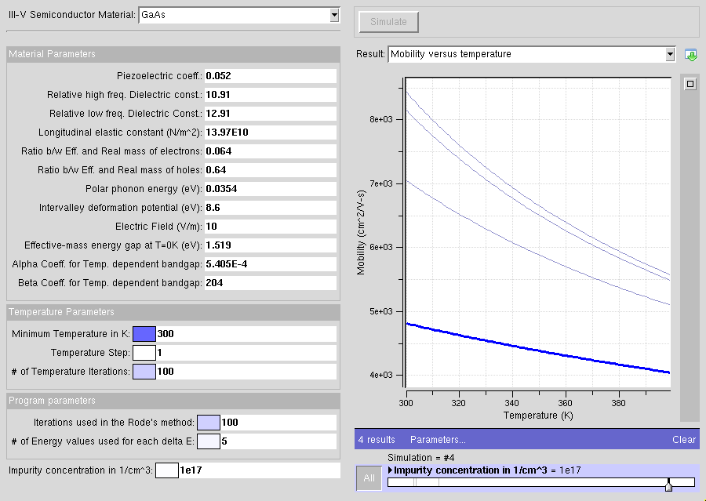
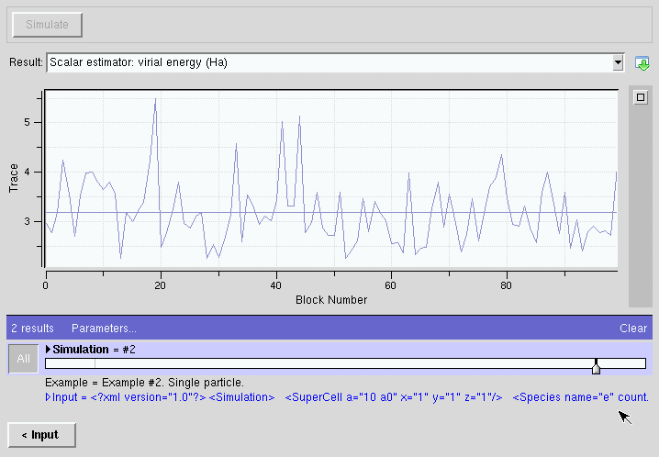
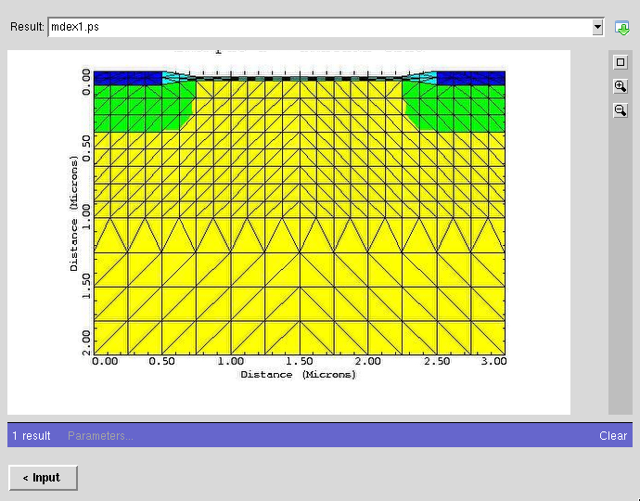
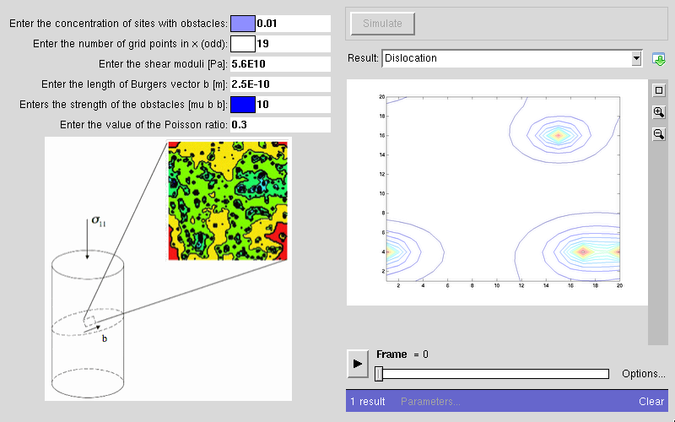
Used to deploy hundreds of tools

Slide 6



Three parts
Builder
Runner
Tester
rappture -builder
rappture
rappture -run
rappture -tester
<XML>
<XML>
<XML>
<XML>
<XML>
tool.xml
tool.xml
run.xml
tool.xml
tests
Generates tool description
Reads tool description
Generates simulation results
Reads tool description
Runs tests and compares results

Slide 7
Rappture Builder
3
Click on the “Preview” tab
to preview your tool
4
Save your tool.xml file
1
Drag controls
from the palette
and drop in
inputs/ouputs
2
Click on a control
and edit its parameters

Slide 8

Demo: Hello, World!
name
string
exclaim
boolean
string
string
program
boolean
result
string
Takes a name and an “enthusiasm” level
Enthusiasm adds an exclamation point
Produces a “hello, world” string

